Slide 1
Dream Album
Haotian Zhang, He Xi
Notes:
As the video showed, today we are going to talk about the Dream Album, the tool that helps you remember and log your dream.

Slide 2
Contents
Why we need this system?
Why this idea working?
What’s the system like
What’s the final result
Notes:
We are only going to talk about why we need this, and why this idea will work?

Slide 3
Why we need it?
To save our dream
To log our dreams
To prevent consolidation
Notes:
So why do we need it? As the video told us, the dream will fade away after we woke up, and some of us want to save it, maybe read it a few days later. The Dream Album is basically for this propose. Further, it can prevent the memory consolidation, sometimes our dream memory will disrupt our normal memory, this could also work for make the dream memory safe.

Slide 4
What’s the idea?
Detect the dream
Catch the emotions
Create album
Notes:
The idea of the system can be divided into 3 part, detect you are dreaming, catch your emotions on your face, and create a album that contains the guessing and your emotions

Slide 5
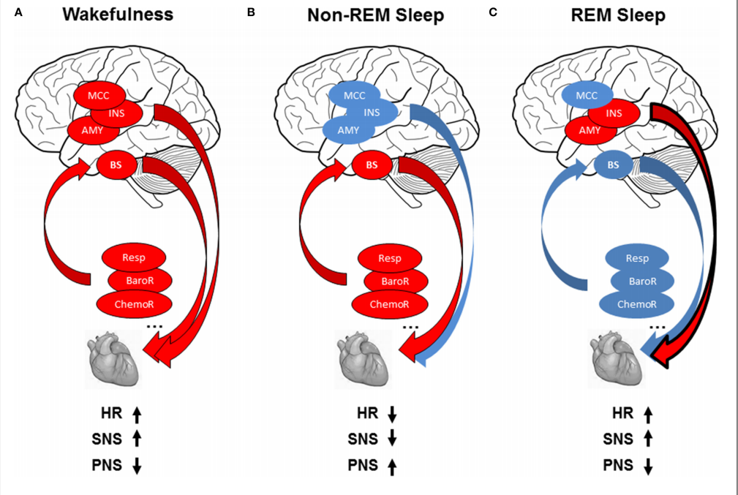
Why will it work?
Detect the dream
Catch the emotions
Create album
Human dreams at the Rapid Eye Movement(REM) period
When REM the heartrate will change
The change is big enough to measure
Chouchou, Florian, and Martin Desseilles. "Heart rate variability: a tool to explore the sleeping brain?." Frontiers in neuroscience 8 (2014): 402.
Notes:
Then let’s see why this process will work. At first, the detection part. The dream detection is the most important part of the project, this ensures you don’t need to spend 7 or 8 hours to go over all the memories you have to try to get something when all your memoirs dead, and got nothing at last. This detection based on 3 fact, the first one is We dream at the REM period, the studies shows we always dreaming when we wake up by others at the REM stage. And at REM stage, our heart rate have a significant change that can be detected with even our own eyes looking at the heart measurement. All these 3 points makes the detection possible and reliable.

Slide 6
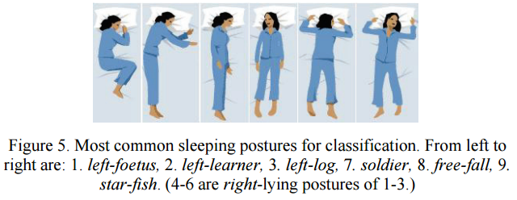
Why will it work?
Detect the dream
Catch the emotions
Create album
The face emotions are related to the dreams
The face emotions can be captured
The face emotions can help to recall the memory
Huang, Weimin, et al. "Multimodal sleeping posture classification." Pattern Recognition (ICPR), 2010 20th International Conference on. IEEE, 2010.a
Notes:
After we detected the dream, we need to capture some useful data. And as the study shows the face emotions are the most valuable data. The emotions are proved related to the dreams we are having. And the face is easy to capture instead of the voice information, as the picture shows, we normally have 9 kinds of posture during the sleep, and all of them can all show at least half of the face information, that should be enough for the emotion recognition works . Also, the emotions can help the most to recall the memory, as we talked about at the start, when you remember the emotion, normally you can remember the fragment.

Slide 7
Why will it work?
Detect the dream
Catch the emotions
Create album
The fast memory recall
Emotions
Guessing
The fast memory logging
Type
Drawing
Notes:
And then form the data into a timeline based format. In this part, we need to notice that this is used when the user are just awake, most of us will be a bit stupid at that time, so we need to make things more obvious. First is the memory recall, instead only show the emotions of the user, we also want to show the face recognition result, and a couple guessing if we have enough data of the users. For they might need some help and improve the speed
And for the fast logging, we provide the typing on the UI, and a paper can draw some details that could be useful but need more time to describe in text.

Slide 8
Why it will work?
Emotions can recall the human memories
Still remember some fragments when wake up
Memories are strongly link with the emotions
Notes:
So why this kind of idea will work? First, the emotions are confirmed that can recall the human memories. And you still remember some fragments of your dream when you wake up, of course they will disappear in a few minis, but when you just woke up, they are still there. So the idea is to help you grab the fragments you have, to log them or relearn them to your long- term memory

Slide 9
What’s the system like?
Smart watch for heart rate
Webcam for face capture
Program analysis the data and control equipment
UI provide the useful data and log function
webcam
program
UI
Smart watch
Notes:
So that’s the whole idea of the system, this is how the system will be like. The webcam and smartwatch to capture data, the program analysis data and control the equipment, UI for user to fast log the dreams. That’s all our project like. Thank you for your attention

Slide 10
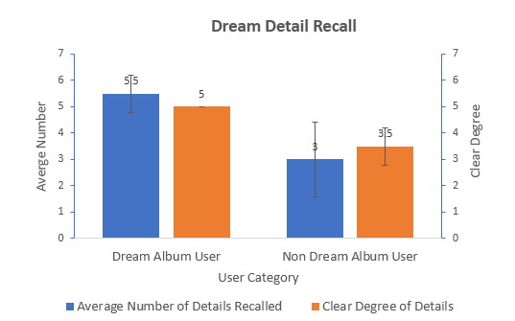
The result of the system
Remember more details
More clearly

Slide 11
Q&A

Slide 12
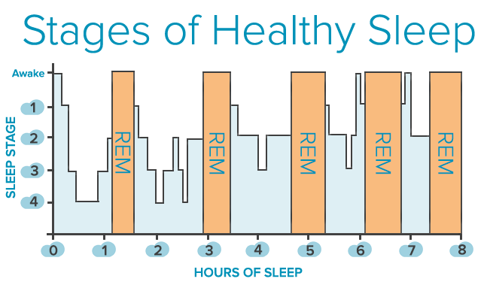
Sleeping stages

